Slide 1

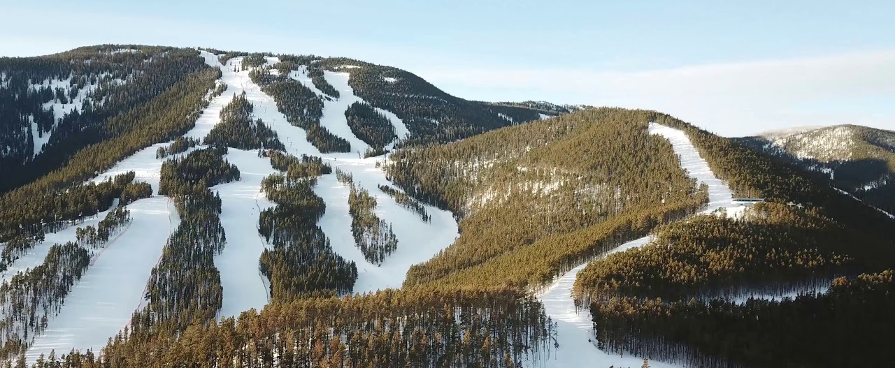
Price and Operating Cost Analysis
Big Mountain resort
April 2023

Slide 2
Background / Problem
Big Mountain Resort is a Montana ski resort with 105 trails. It receives 350,000 people every year and accommodates all levels.
It needs to increase revenues or decrease operating costs due to the acquisition of a new chair lift that increases operating costs by $1,540,000 for the season.
Management has the perception that they are not capitalizing on its current facilities so their price strategy should be re-examined.
Data was provided for 330 different ski resorts across the US with 27 different features that was analyzed to generate the optimal price model.

Slide 3
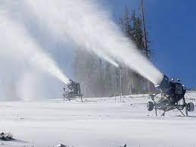
Key findings and Recommendations
The model predicted a ticket price for Big Mountain Resort of $95.87 and the current price is $81.00.
The fact that the modelled price was well above the current price could be due to that Big Mountain resort ranked high among other US resorts when comparing the different features.

Slide 4
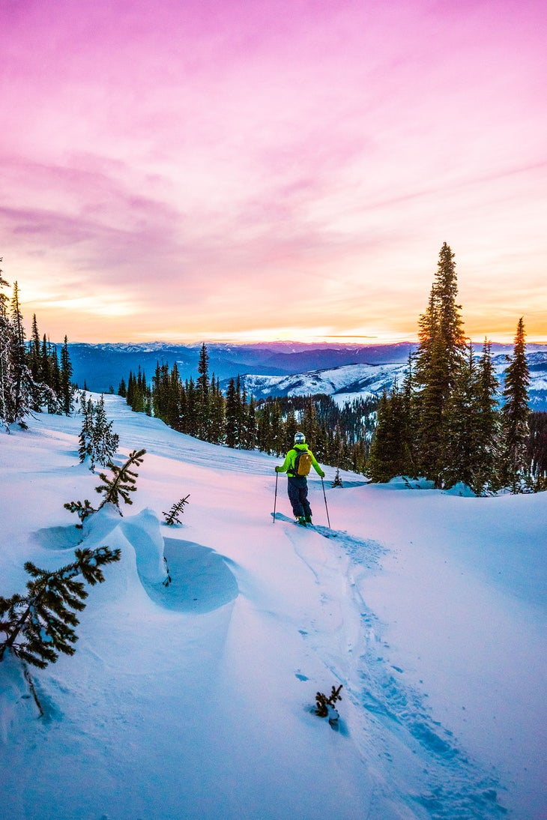
Modeling analysis
We performed data wrangling to clean and improve the data usability.
Then the data was explored by applying different techniques and we found that there wasn’t a clear pattern with price data at the state level so we focused at the resort level across the different features.

Slide 5
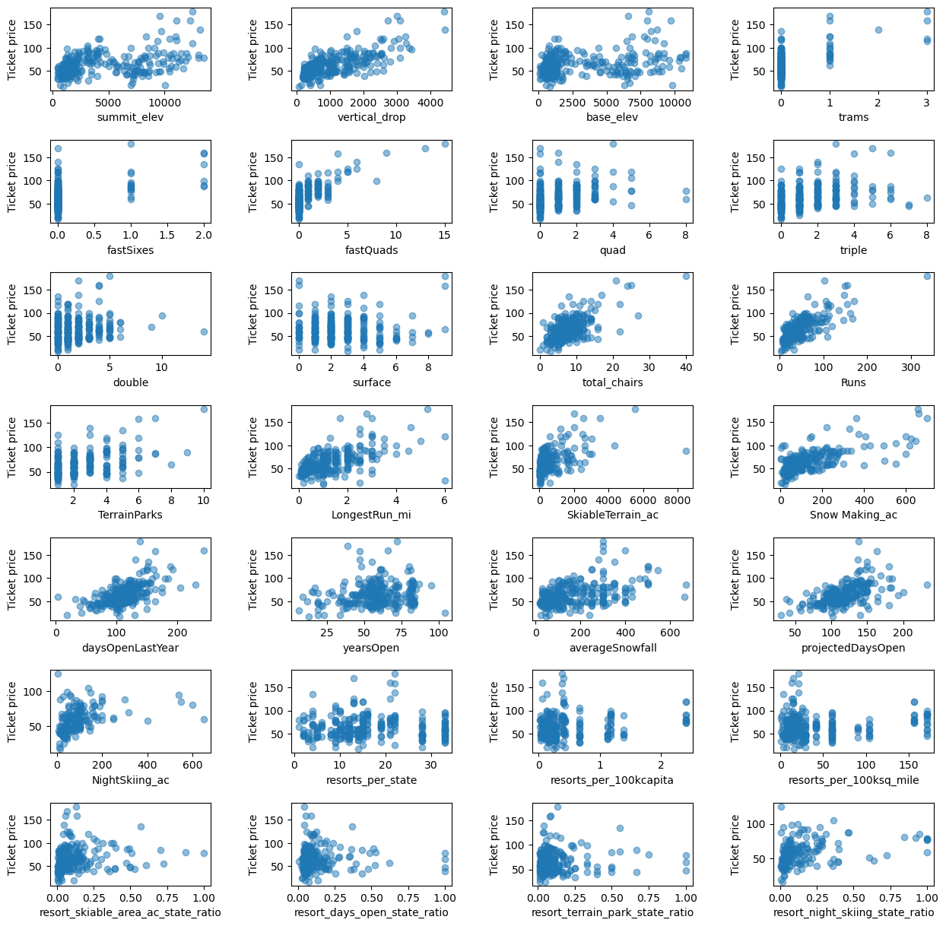
Visual Correlations
By looking at the scatter plots generated comparing the prices across resorts there were high visual correlations that stand out like vertical drop, fast quads, total chairs, runs, longest run, skiable terrain, snow making and projected days open. This was very useful information for our price model.

Slide 6
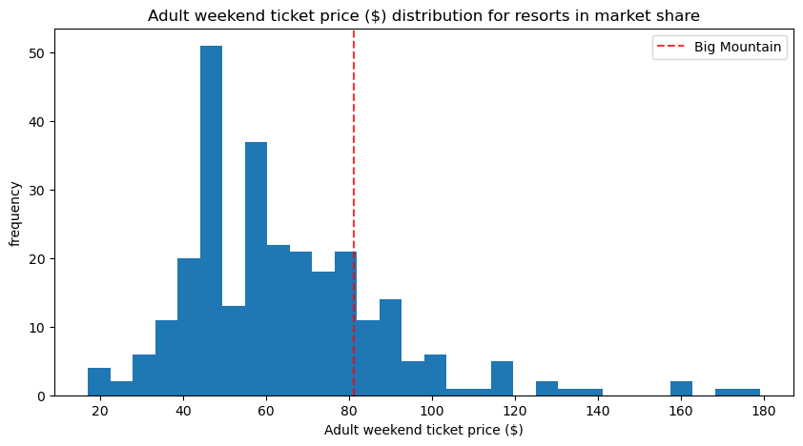
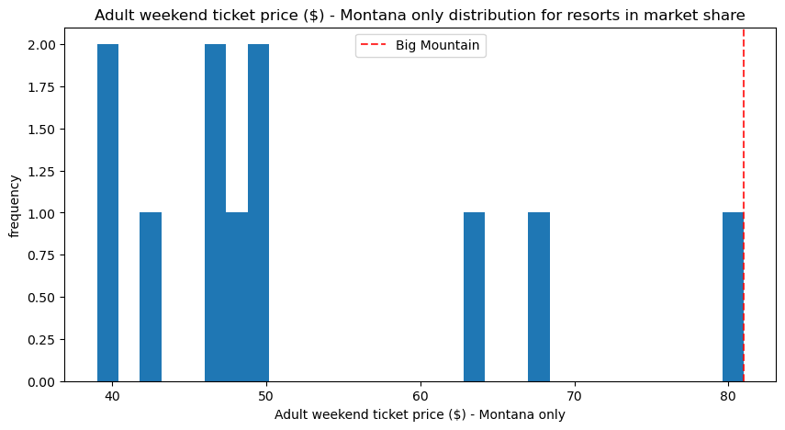
Comparison of Ticket Prices
Big Mountain Resort is a little higher the mean of US ticket prices of ski resorts (chart at top - Big Mountain is represented with the red dotted line)
It is the most expensive resort in Montana (bottom chart)

Slide 7
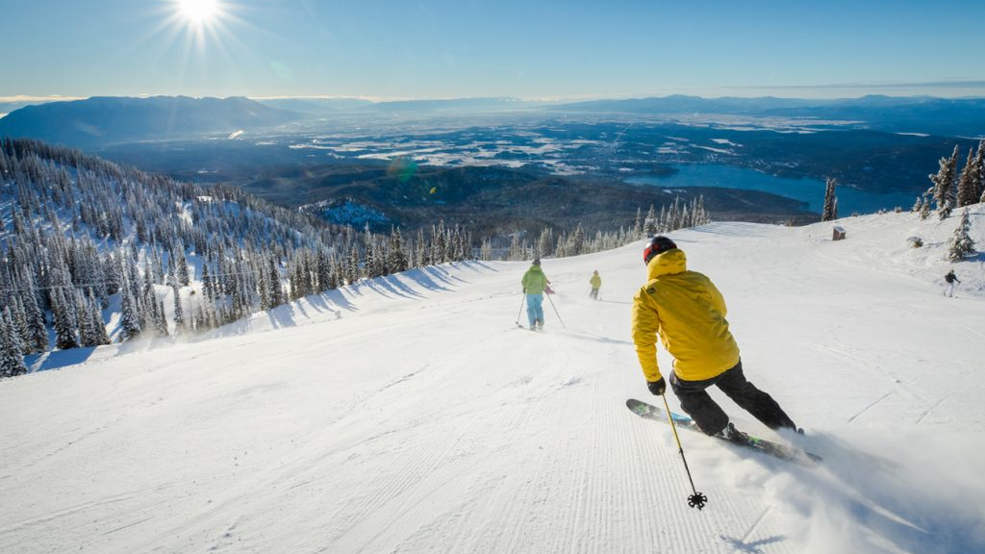
Modeling Results
We then processed and built models trying three different types:
average price (simplest)
linear regression model
random forest model (creates subsets of the dataset to arrive at the best subset of features)
By using a validation technique, we concluded that the random forest model was the best one with the lowest errors and less variability.
The most important features for estimating ticket price were fast quads, runs, snow making and vertical drop.

Slide 8
Modeling Results cont’d
Once we had the selected model, we were able to create different scenarios. These considered:
closing runs
opening runs
increasing the vertical drop
installing an additional chair
increasing snow making
increasing the longest run
As we changed these different features the modelled price increased or decreased depending on the scenario.

Slide 9
Summary and conclusion
Big Mountain resort should increase their ticket price by at least $90,00. This is supported by the price model that considered all the different facilities of US ski resorts across its market segment
It would be extremely useful to develop a program or app for business management to be able to run scenarios on their own by changing the different features such as, vertical drop, snow making, longest run, etc.
The output would be the new price (lower or higher), total revenue (given the new price) and impact on operating costs.
To explore this option, we would need the cost information of snow making per acre, grooming per acre and any other additional costs of creating newly skiable acres.

